Slide 1

Market Analysis Report for Mystic Spice Premium Chai Tea
Notes:
This presentation was automatically generated by PowerPoint Copilot based on content found in this document: https://microsoft-my.sharepoint.com/personal/dahans_microsoft_com/Documents/MS-4005/Market%20Analysis%20Report%20for%20Mystic%20Spice%20Premium%20Chai%20Tea.docx AI-generated content may be incorrect.

Slide 2
Agenda
Introduction
Product Description
Product Description (1/2)
Product Description (2/2)
Market Trend and Demand
Market Share of Chai Tea in Latin America
Distribution Channels
Promotion Plan and Strategy
Expected Outcomes and Challenges
Recommendations and Conclusions
Notes:
Agenda * Introduction * Product Description * Product Description (1/2) * Product Description (2/2) * Market Trend and Demand * Competitive Analysis * Tetley * Teavana * David's Tea * Local Brands * Market Share of Chai Tea in Latin America * Distribution Channels * Retailers * Wholesalers * Distributors * Promotion Plan and Strategy * Expected Outcomes and Challenges * Expected Outcomes * Potential Challenges * Recommendations and Conclusions

Slide 3

Introduction
Product Description, Features, and Benefits
Market Trend and Demand in Latin America
Competitive Analysis in Latin America
Distribution Channels in Latin America
Promotion Plan and Strategy in Latin America
Expected Outcomes and Challenges
Recommendations and Conclusions
Notes:
This report provides a market analysis for Mystic Spice Premium Chai Tea in the Latin American region. It covers the product description, market trend, competitive analysis, distribution channels, promotion plan, expected outcomes, and recommendations for the future. Original Content: Introductions Mystic Spice Premium Chai Tea is a new product launched by Contoso Beverage, a company that specializes in producing and distributing high-quality beverages around the world. Mystic Spice Premium Chai Tea is a spiced tea drink that originated in India and has become popular around the world. It is a versatile beverage that can be enjoyed hot or cold, with or without milk, and with different spices and sweeteners. Chai tea has many health benefits, such as boosting immunity, reducing inflammation, and improving digestion. It also has a rich cultural and historical significance, as it is often associated with hospitality, friendship, and relaxation. The purpose of this report is to provide a market analysis for Mystic Spice Premium Chai Tea, focusing on the Latin American region. The report will cover the following aspects: · The product description, features, and benefits of Mystic Spice Premium Chai Tea · The market trend and demand for Chai tea in Latin America · The competitive analysis of Chai tea in Latin America · The distribution channels for Chai tea in Latin America · The promotion plan and strategy for Chai tea in Latin America · The expected outcomes and challenges of the promotion plan · The recommendations and conclusions for the future of Chai tea in Latin America

Slide 4
Product Description
Product Description | Features | Benefits
Mystic Spice Premium Chai Tea | Meticulously crafted blend | Authentic chai experience
Meticulously crafted blend
Pays homage to the timeless traditions of Indian chai
Enchanting journey through the vibrant landscapes of India
Brings an authentic chai experience right in your home
Notes:
Mystic Spice Premium Chai Tea is a carefully crafted blend that honors the traditions of Indian chai. Each cup takes you on a journey through India's vibrant landscapes, bringing an authentic chai experience to your home. Original Content: Product Description Mystic Spice Premium Chai Tea is a meticulously crafted blend that pays homage to the timeless traditions of Indian chai. Each cup offers an enchanting journey through the vibrant landscapes of India, bringing you an authentic chai experience right in your home. The product description, features, and benefits of Mystic Spice Premium Chai Tea are summarized in the table below:

Slide 5
Product Description (1/2)
Product Name | Product Description
Mystic Spice Premium Chai Tea | Indulge in the rich and aromatic embrace of Mystic Spice Premium Chai Tea, a meticulously crafted blend that pays homage to the timeless traditions of Indian chai. Each cup offers an enchanting journey through the vibrant landscapes of India, bringing you an authentic chai experience right in your home.
Key Features | Key Benefits
Authentic Blend: Our chai is a harmonious mix of premium black tea leaves and a signature selection of ground spices, including cinnamon, cardamom, cloves, ginger, and black pepper. This age-old recipe promises an authentic and robust flavor in every sip. | Health-Enhancing Ingredients: Each ingredient in Mystic Spice Chai Tea is chosen for its natural health benefits. Ginger and cardamom aid in digestion, cinnamon helps regulate blood sugar, and cloves add a boost of antioxidants.
Notes:
undefined

Slide 6
Product Description (2/2)
Product Name | Product Description
Rich Aroma and Flavor: The warm, spicy aroma and deep, invigorating taste of our chai make it the perfect beverage to start your day or unwind in the evening. The flavors are intense yet balanced, creating a comforting and soothing experience. | Versatile Brewing Options: Whether you love your chai steaming hot, as a refreshing iced tea, or as a creamy latte, our blend is versatile enough to suit any preference. Easy brewing instructions are included to help you enjoy your chai just the way you like it.
Sustainably Sourced: Committed to sustainability, we source our ingredients from small-scale farms that practice organic farming, ensuring not only the finest quality but also the welfare of our planet. | Elegant Packaging: Mystic Spice Chai Tea comes in beautifully designed, eco-friendly packaging, making it an ideal gift for tea lovers or a luxurious treat for yourself.
Customer Satisfaction Guarantee: We stand behind our product and offer a satisfaction guarantee. If Mystic Spice Chai Tea doesn’t meet your expectations, we are committed to making it right. | Ideal For: Tea enthusiasts, health-conscious individuals, lovers of warm, spicy beverages, and anyone looking to explore the rich flavors of traditional Indian chai.
Notes:
undefined

Slide 7
Market Trend and Demand
Region | Chai Tea Market Size (USD billion) | CAGR (2020-2027)
Global | 1.9 | 5.5%
Latin America | N/A | 6.2%
Latin America offers a great opportunity for Chai tea
Growing demand for healthy, natural, and exotic products
Strong tea culture in countries like Argentina, Chile, and Uruguay
Chai tea can appeal to both tea and coffee lovers
Chai tea fits into the lifestyle and preferences of Latin American consumers
Global Chai tea market size was valued at USD 1.9 billion in 2019
Expected to grow at a CAGR of 5.5% from 2020 to 2027
Latin America is one of the fastest-growing regions for Chai tea
Main drivers for growth include increasing awareness, rising disposable income, and expanding distribution
Notes:
The Latin American market offers a great opportunity for Chai tea, with a growing demand for healthy, natural, and exotic products. The global Chai tea market size was valued at USD 1.9 billion in 2019 and is expected to grow at a CAGR of 5.5% from 2020 to 2027, with Latin America being one of the fastest-growing regions. The main drivers for growth include increasing awareness, rising disposable income, and expanding distribution. Original Content: Market Trend and Demand The Latin American market offers a great opportunity for Chai tea, as the region has a growing demand for healthy, natural, and exotic products. The region also has a strong tea culture, especially in countries like Argentina, Chile, and Uruguay, where mate is a popular drink. Chai tea can appeal to both tea lovers and coffee drinkers, as it offers a similar caffeine boost and a more complex flavor profile. Chai tea can also fit into the lifestyle and preferences of Latin American consumers, who enjoy socializing, sharing, and indulging in sweet treats. According to a report by Grand View Research, the global Chai tea market size was valued at USD 1.9 billion in 2019 and is expected to grow at a compound annual growth rate (CAGR) of 5.5% from 2020 to 2027. The report also states that Latin America is one of the fastest-growing regions for Chai tea, with a CAGR of 6.2% from 2020 to 2027. The main drivers for the growth of Chai tea in Latin America are: · The increasing awareness and interest in the health benefits and cultural aspects of Chai tea · The rising disposable income and spending power of the middle-class consumers · The growing popularity of specialty and premium teas among the younger and urban segments · The expanding distribution and availability of Chai tea products in various channels, such as supermarkets, cafes, and online platforms · The emergence of new and innovative flavors and formats of Chai tea, such as ready-to-drink, instant, and organic varieties

Slide 8
Distribution Channels: Retailers
Retailers: Sell Chai tea products directly to consumers
Supermarkets, convenience stores, specialty stores, cafes, and online platforms
Influence consumer perception, preference, and purchase
Offer promotional and merchandising support
Major retailers
Wholesalers: Sell Chai tea products in bulk to retailers
Distributors: Transport Chai tea products from manufacturers to retailers
Notes:
Chai tea in Latin America is distributed through retailers, wholesalers, and distributors. Retailers, such as supermarkets and cafes, sell directly to consumers and can influence their perception and purchase. Major retailers include Walmart and Starbucks. Wholesalers sell in bulk to retailers, while distributors transport products from manufacturers to retailers. Original Content: The distribution channels for Chai tea in Latin America are the ways and means by which Chai tea products are delivered and sold to the final consumers. The distribution channels for Chai tea in Latin America can be classified into three types: retailers, wholesalers, and distributors. Retailers are the businesses that sell Chai tea products directly to the consumers, such as supermarkets, convenience stores, specialty stores, cafes, and online platforms. Retailers are the most visible and accessible channel for Chai tea products, and they can influence the consumer's perception, preference, and purchase of Chai tea products. Retailers can also offer promotional and merchandising support for Chai tea products, such as displays, signage, and shelf space. Some of the major retailers of Chai tea products in Latin America are Walmart, Carrefour, Oxxo, Starbucks, and Amazon.

Slide 9
Distribution Channels: Wholesalers
Wholesalers buy Chai tea products in bulk from manufacturers or distributors
They sell to retailers or other intermediaries
Wholesalers link supply and demand of Chai tea products
They offer economies of scale, storage, and transportation services
Wholesalers provide market information, feedback, and credit facilities
Notes:
Wholesalers buy Chai tea products in bulk and sell them to retailers or other intermediaries. They link the supply and demand of Chai tea products and offer various services. Major wholesalers in Latin America include Cencosud, Grupo Pao de Acucar, La Anonima, and Makro. Original Content: Wholesalers are the businesses that buy Chai tea products in bulk from the manufacturers or distributors and sell them to the retailers or other intermediaries. Wholesalers are the link between the supply and the demand of Chai tea products, and they can offer economies of scale, storage, and transportation services for Chai tea products. Wholesalers can also provide market information, feedback, and credit facilities for Chai tea products. Some of the major wholesalers of Chai tea products in Latin America are Cencosud, Grupo Pao de Acucar, La Anonima, and Makro.

Slide 10
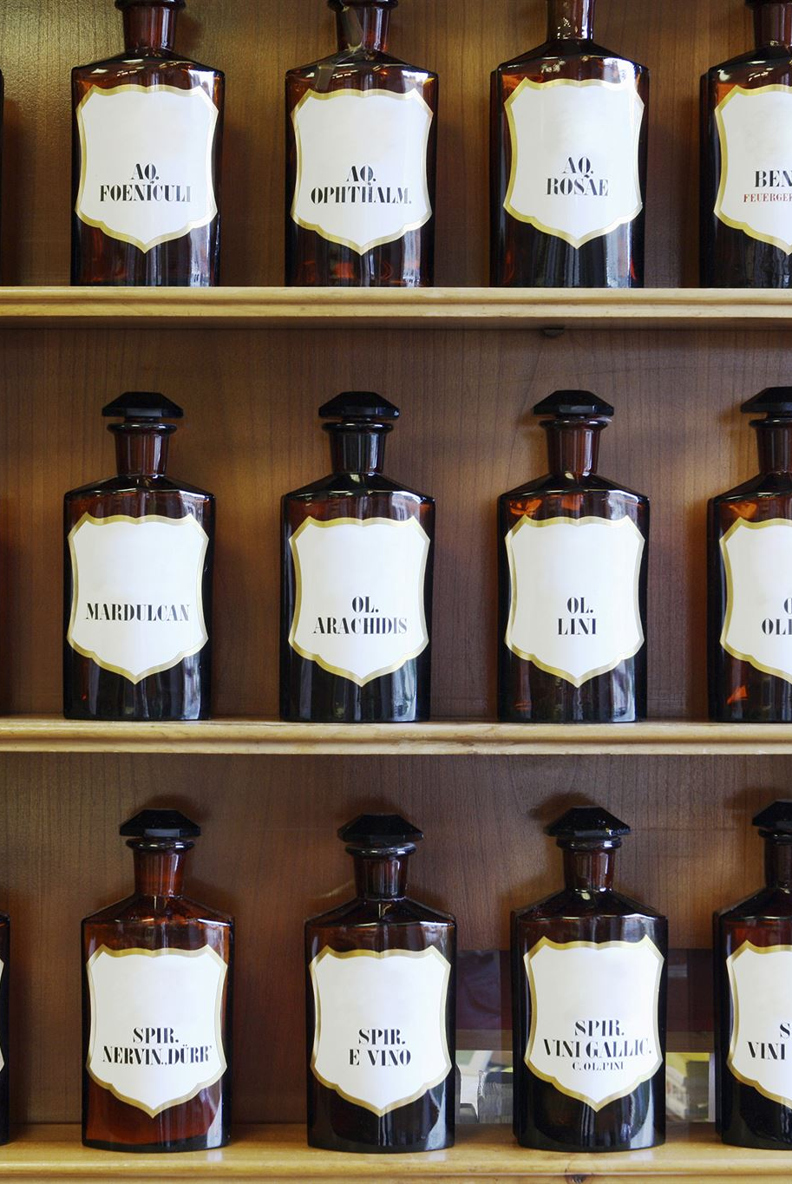
Distribution Channels: Distributors
Role of Distributors
Represent and distribute Chai tea products
Facilitate movement and sale in different markets
Offer marketing, sales, and after-sales services
Relationships
Establish and maintain relationships with retailers and consumers
Provide technical and logistical support
Major Distributors in Latin America
Tailwind traders
Woodgrove Groceries
Notes:
Distributors represent and distribute Chai tea products, facilitate their movement and sale, and offer marketing, sales, and after-sales services. They establish and maintain relationships with retailers and consumers, and provide technical and logistical support. Major distributors in Latin America include Unilever, Nestle, Coca-Cola, and PepsiCo. Original Content: Distributors are the businesses that represent and distribute Chai tea products on behalf of the manufacturers or wholesalers. Distributors are the agents that facilitate the movement and sale of Chai tea products in different markets and regions, and they can offer marketing, sales, and after-sales services for Chai tea products. Distributors can also establish and maintain relationships with the retailers and consumers, and provide technical and logistical support for Chai tea products. Some of the major distributors of Chai tea products in Latin America are Unilever, Nestle, Coca-Cola, and PepsiCo.

Slide 11
Promotion Plan and Strategy
Objectives of the promotion plan and strategy
Increase awareness and interest in Chai tea among the target audience
Position Chai tea as a premium, natural, and healthy product
Encourage trial and purchase of Chai tea through various channels and incentives
Build loyalty and retention among Chai tea consumers
Tactics used in the promotion plan and strategy
Creating a catchy and memorable brand name and logo for Chai tea
Developing a website and social media presence for Chai tea
Launching a digital marketing campaign
Distributing free samples and coupons of Chai tea
Organizing events and contests
Implementation and evaluation of the promotion plan and strategy
Notes:
The promotion plan and strategy for Chai tea in Latin America aims to increase awareness, position it as a premium product, encourage trial and purchase, and build loyalty. Tactics include creating a brand name and logo, developing a website and social media presence, launching a digital marketing campaign, distributing free samples, organizing events, and partnering with local businesses. The plan will be implemented over 12 months with a budget of $100,000 and evaluated using key performance indicators. Original Content: Promotion Plan and Strategy The promotion plan and strategy for Chai tea in Latin America aims to achieve the following objectives: · Increase awareness and interest in Chai tea among the target audience · Position Chai tea as a premium, natural, and healthy product that offers a unique and satisfying experience · Encourage trial and purchase of Chai tea through various channels and incentives · Build loyalty and retention among Chai tea consumers through engagement and feedback The promotion plan and strategy for Chai tea in Latin America will use a combination of tactics, such as: · Creating a catchy and memorable brand name and logo for Chai tea · Developing a website and social media presence for Chai tea that showcases its benefits, features, and stories · Launching a digital marketing campaign that uses SEO, SEM, email marketing, and influencer marketing to reach and attract potential customers · Distributing free samples and coupons of Chai tea in strategic locations, such as supermarkets, cafes, and health stores · Organizing events and contests that invite people to try and share Chai tea with their friends and family · Partnering with local businesses and organizations that share the same values and vision as Chai tea The promotion plan and strategy for Chai tea in Latin America will be implemented over a period of 12 months, with a budget of $100,000. The plan will be monitored and evaluated using key performance indicators, such as website traffic, social media engagement, email open rates, conversion rates, sales volume, customer satisfaction, and retention rates.

Slide 12

Expected Outcomes and Challenges: Expected Outcomes
20% increase in awareness and interest in Chai tea among target audience
10% increase in market share of Chai tea in the region
15% increase in sales volume and revenue of Chai tea in the region
25% increase in customer satisfaction and retention rates of Chai tea in the region
Notes:
The promotion plan and strategy for Chai tea in Latin America is expected to result in a 20% increase in awareness and interest, a 10% increase in market share, a 15% increase in sales volume and revenue, and a 25% increase in customer satisfaction and retention rates. Original Content: Expected Outcomes and Challenges The expected outcomes of the promotion plan and strategy for Chai tea in Latin America are: · A 20% increase in the awareness and interest in Chai tea among the target audience · A 10% increase in the market share of Chai tea in the region · A 15% increase in the sales volume and revenue of Chai tea in the region · A 25% increase in the customer satisfaction and retention rates of Chai tea in the region

Slide 13
Expected Outcomes and Challenges: Potential Challenges
High price and low affordability of Chai tea products compared to other beverages
Lack of awareness and familiarity with Chai tea among some segments of the population
Competition from other tea products, such as herbal, green, and black teas
Regulatory and cultural barriers that may limit the entry and expansion of Chai tea products in some countries
Environmental and social issues that may affect the supply and quality of Chai tea ingredients
Notes:
The promotion plan and strategy for Chai tea in Latin America faces several challenges, including high price, lack of awareness, competition from other tea products, regulatory and cultural barriers, and environmental and social issues that may affect the supply and quality of Chai tea ingredients. Original Content: The potential challenges of the promotion plan and strategy for Chai tea in Latin America are: · The high price and low affordability of Chai tea products compared to other beverages · The lack of awareness and familiarity with Chai tea among some segments of the population · The competition from other tea products, such as herbal, green, and black teas · The regulatory and cultural barriers that may limit the entry and expansion of Chai tea products in some countries · The environmental and social issues that may affect the supply and quality of Chai tea ingredients

Slide 14
Recommendations and Conclusions
Chai tea is a promising product with potential for growth in the Latin American market
Offers a healthy, natural, and exotic alternative to other beverages
Position and market Chai tea as a premium, authentic, and versatile product
Appeals to different segments and occasions
Leverage unique features and benefits, such as rich aroma, flavor, and health benefits
Differentiates from other tea products
Use a mix of online and offline tactics to reach and engage target audience
Create a loyal and satisfied customer base
Overcome challenges and threats, such as price, awareness, competition, regulation, and sustainability
Constantly monitor, evaluate, and adjust promotion plan and strategy
Notes:
Chai tea is a promising product in the Latin American market, offering a healthy and exotic alternative. It should be positioned as a premium and versatile product, leveraging its unique features and benefits. A mix of online and offline tactics should be used to reach the target audience and overcome challenges. Original Content: Recommendations and Conclusions Based on the market analysis, the competitive analysis, the distribution channels, and the promotion plan and strategy, the following recommendations and conclusions can be drawn for the future of Chai tea in Latin America: · Chai tea is a promising product that has a potential to grow and succeed in the Latin American market, as it offers a healthy, natural, and exotic alternative to other beverages · Chai tea needs to be positioned and marketed as a premium, authentic, and versatile product that can appeal to different segments and occasions · Chai tea needs to leverage its unique features and benefits, such as its rich aroma, flavor, and health benefits, to differentiate itself from other tea products · Chai tea needs to use a mix of online and offline tactics to reach and engage with the target audience, and to create a loyal and satisfied customer base · Chai tea needs to overcome the challenges and threats that may hinder its growth and expansion in the region, such as price, awareness, competition, regulation, and sustainability In conclusion, Chai tea is a product that has a lot of potential and opportunities in the Latin American market, but also faces some challenges and risks. The promotion plan and strategy outlined in this report aims to address these issues and to achieve the desired outcomes. However, the promotion plan and strategy needs to be constantly monitored, evaluated, and adjusted according to the changing market conditions and customer feedback.

